Slide 1
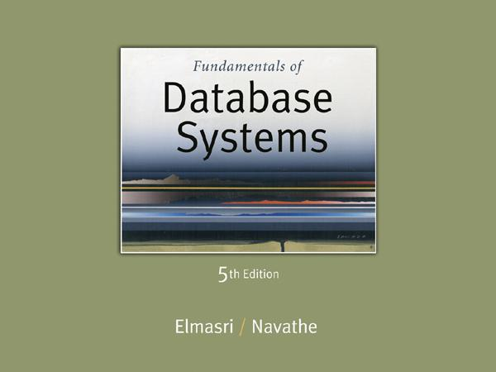
Slide 8- ‹#›
Notes:
‹#›

Slide 2
Chapter 8
SQL-99: SchemaDefinition, Constraints, and Queries and Views
Copyright © 2007 Ramez Elmasri and Shamkant B. Navathe
Notes:
‹#›

Slide 3
Data Definition, Constraints, and Schema Changes
Used to CREATE, DROP, and ALTER the descriptions of the tables (relations) of a database
Slide 8- ‹#›
Notes:
‹#›

Slide 4
CREATE TABLE
Specifies a new base relation by giving it a name, and specifying each of its attributes and their data types (INTEGER, FLOAT, DECIMAL(i,j), CHAR(n), VARCHAR(n))
A constraint NOT NULL may be specified on an attribute CREATE TABLE DEPARTMENT ( DNAME VARCHAR(10) NOT NULL, DNUMBER INTEGER NOT NULL, MGRSSN CHAR(9), MGRSTARTDATE CHAR(9) );
Slide 8- ‹#›
Notes:
‹#›

Slide 5
CREATE TABLE
In SQL2, can use the CREATE TABLE command for specifying the primary key attributes, secondary keys, and referential integrity constraints (foreign keys).
Key attributes can be specified via the PRIMARY KEY and UNIQUE phrases
CREATE TABLE DEPT (
DNAME VARCHAR(10) NOT NULL,
DNUMBER INTEGER NOT NULL,
MGRSSN CHAR(9),
MGRSTARTDATE CHAR(9),
PRIMARY KEY (DNUMBER),
UNIQUE (DNAME),
FOREIGN KEY (MGRSSN) REFERENCES EMP );
Slide 8- ‹#›
Notes:
‹#›

Slide 6
DROP TABLE
Used to remove a relation (base table) and its definition
The relation can no longer be used in queries, updates, or any other commands since its description no longer exists
Example: DROP TABLE DEPENDENT;
Slide 8- ‹#›
Notes:
‹#›

Slide 7
ALTER TABLE
Used to add an attribute to one of the base relations
The new attribute will have NULLs in all the tuples of the relation right after the command is executed; hence, the NOT NULL constraint is not allowed for such an attribute
Example: ALTER TABLE EMPLOYEE ADD JOB VARCHAR(12);
The database users must still enter a value for the new attribute JOB for each EMPLOYEE tuple.
This can be done using the UPDATE command.
Slide 8- ‹#›
Notes:
‹#›

Slide 8
Features Added in SQL2 and SQL-99
Create schema
Referential integrity options
Slide 8- ‹#›
Notes:
‹#›

Slide 9
CREATE SCHEMA
Specifies a new database schema by giving it a name
Slide 8- ‹#›
Notes:
‹#›

Slide 10
REFERENTIAL INTEGRITY OPTIONS
We can specify RESTRICT, CASCADE, SET NULL or SET DEFAULT on referential integrity constraints (foreign keys)
CREATE TABLE DEPT ( DNAME VARCHAR(10) NOT NULL, DNUMBER INTEGER NOT NULL, MGRSSN CHAR(9), MGRSTARTDATE CHAR(9), PRIMARY KEY (DNUMBER), UNIQUE (DNAME), FOREIGN KEY (MGRSSN) REFERENCES EMP ON DELETE SET DEFAULT ON UPDATE CASCADE);
Slide 8- ‹#›
Notes:
‹#›

Slide 11
REFERENTIAL INTEGRITY OPTIONS (continued)
CREATE TABLE EMP( ENAME VARCHAR(30) NOT NULL, ESSN CHAR(9), BDATE DATE, DNO INTEGER DEFAULT 1, SUPERSSN CHAR(9), PRIMARY KEY (ESSN), FOREIGN KEY (DNO) REFERENCES DEPT ON DELETE SET DEFAULT ON UPDATE CASCADE, FOREIGN KEY (SUPERSSN) REFERENCES EMP ON DELETE SET NULL ON UPDATE CASCADE);
Slide 8- ‹#›
Notes:
‹#›

Slide 12
Additional Data Types in SQL2 and SQL-99
Has DATE, TIME, and TIMESTAMP data types
DATE:
Made up of year-month-day in the format yyyy-mm-dd
TIME:
Made up of hour:minute:second in the format hh:mm:ss
TIME(i):
Made up of hour:minute:second plus i additional digits specifying fractions of a second
format is hh:mm:ss:ii...i
Slide 8- ‹#›
Notes:
‹#›

Slide 13
Additional Data Types in SQL2 and SQL-99 (contd.)
TIMESTAMP:
Has both DATE and TIME components
INTERVAL:
Specifies a relative value rather than an absolute value
Can be DAY/TIME intervals or YEAR/MONTH intervals
Can be positive or negative when added to or subtracted from an absolute value, the result is an absolute value
Slide 8- ‹#›
Notes:
‹#›

Slide 14
Retrieval Queries in SQL
SQL has one basic statement for retrieving information from a database; the SELECT statement
This is not the same as the SELECT operation of the relational algebra
Important distinction between SQL and the formal relational model:
SQL allows a table (relation) to have two or more tuples that are identical in all their attribute values
Hence, an SQL relation (table) is a multi-set (sometimes called a bag) of tuples; it is not a set of tuples
SQL relations can be constrained to be sets by specifying PRIMARY KEY or UNIQUE attributes, or by using the DISTINCT option in a query
Slide 8- ‹#›
Notes:
‹#›

Slide 15
Retrieval Queries in SQL (contd.)
A bag or multi-set is like a set, but an element may appear more than once.
Example: {A, B, C, A} is a bag. {A, B, C} is also a bag that also is a set.
Bags also resemble lists, but the order is irrelevant in a bag.
Example:
{A, B, A} = {B, A, A} as bags
However, [A, B, A] is not equal to [B, A, A] as lists
Slide 8- ‹#›
Notes:
‹#›

Slide 16
Retrieval Queries in SQL (contd.)
Basic form of the SQL SELECT statement is called a mapping or a SELECT-FROM-WHERE block
SELECT <attribute list>
FROM <table list>
WHERE <condition>
<attribute list> is a list of attribute names whose values are to be retrieved by the query
<table list> is a list of the relation names required to process the query
<condition> is a conditional (Boolean) expression that identifies the tuples to be retrieved by the query
Slide 8- ‹#›
Notes:
‹#›

Slide 17
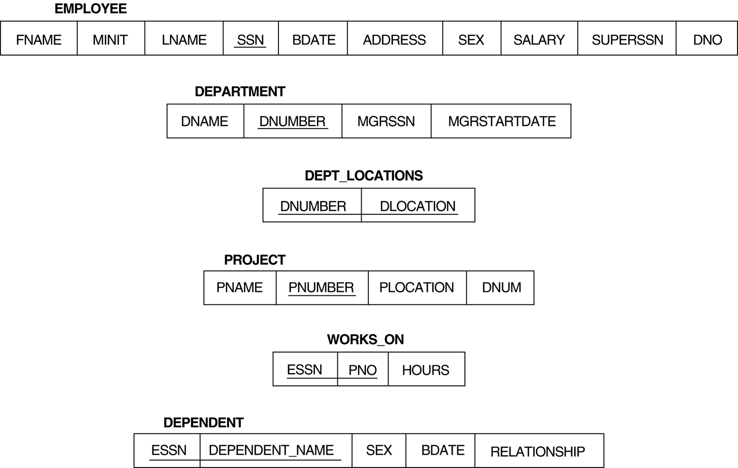
Relational Database Schema--Figure 5.5
Slide 8- ‹#›
Notes:
‹#›

Slide 18
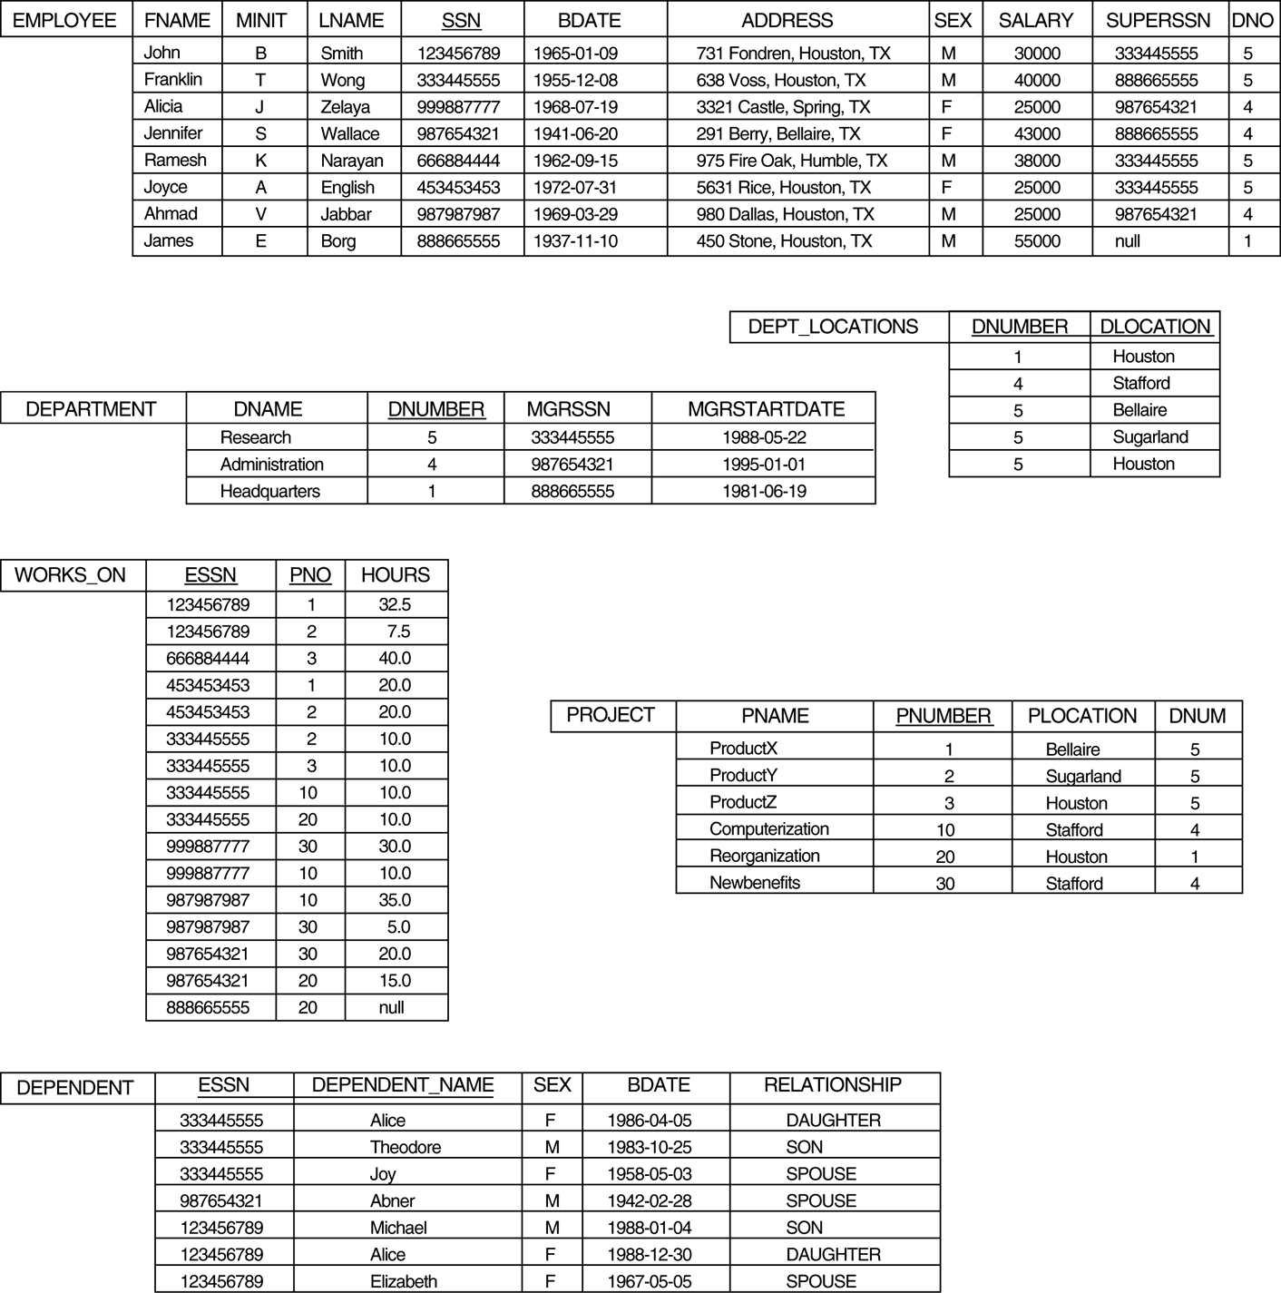
Populated Database--Fig.5.6
Slide 8- ‹#›
Notes:
‹#›

Slide 19
Simple SQL Queries
Basic SQL queries correspond to using the following operations of the relational algebra:
SELECT
PROJECT
JOIN
All subsequent examples use the COMPANY database
Slide 8- ‹#›
Notes:
‹#›

Slide 20
Simple SQL Queries (contd.)
Example of a simple query on one relation
Query 0: Retrieve the birthdate and address of the employee whose name is 'John B. Smith'.
Q0: SELECT BDATE, ADDRESS FROM EMPLOYEE WHERE FNAME='John' AND MINIT='B’ AND LNAME='Smith’
Similar to a SELECT-PROJECT pair of relational algebra operations:
The SELECT-clause specifies the projection attributes and the WHERE-clause specifies the selection condition
However, the result of the query may contain duplicate tuples
Slide 8- ‹#›
Notes:
‹#›

Slide 21
Simple SQL Queries (contd.)
Query 1: Retrieve the name and address of all employees who work for the 'Research' department.
Q1: SELECT FNAME, LNAME, ADDRESS FROM EMPLOYEE, DEPARTMENT WHERE DNAME='Research' AND DNUMBER=DNO
Similar to a SELECT-PROJECT-JOIN sequence of relational algebra operations
(DNAME='Research') is a selection condition (corresponds to a SELECT operation in relational algebra)
(DNUMBER=DNO) is a join condition (corresponds to a JOIN operation in relational algebra)
Slide 8- ‹#›
Notes:
‹#›

Slide 22
Simple SQL Queries (contd.)
Query 2: For every project located in 'Stafford', list the project number, the controlling department number, and the department manager's last name, address, and birthdate.
Q2: SELECT PNUMBER, DNUM, LNAME, BDATE, ADDRESS FROM PROJECT, DEPARTMENT, EMPLOYEE WHERE DNUM=DNUMBER AND MGRSSN=SSN AND PLOCATION='Stafford'
In Q2, there are two join conditions
The join condition DNUM=DNUMBER relates a project to its controlling department
The join condition MGRSSN=SSN relates the controlling department to the employee who manages that department
Slide 8- ‹#›
Notes:
‹#›

Slide 23
Aliases, * and DISTINCT, Empty WHERE-clause
In SQL, we can use the same name for two (or more) attributes as long as the attributes are in different relations
A query that refers to two or more attributes with the same name must qualify the attribute name with the relation name by prefixing the relation name to the attribute name
Example:
EMPLOYEE.LNAME, DEPARTMENT.DNAME
Slide 8- ‹#›
Notes:
‹#›

Slide 24
ALIASES
Some queries need to refer to the same relation twice
In this case, aliases are given to the relation name
Query 8: For each employee, retrieve the employee's name, and the name of his or her immediate supervisor. Q8: SELECT E.FNAME, E.LNAME, S.FNAME, S.LNAME FROM EMPLOYEE E S WHERE E.SUPERSSN=S.SSN
In Q8, the alternate relation names E and S are called aliases or tuple variables for the EMPLOYEE relation
We can think of E and S as two different copies of EMPLOYEE; E represents employees in role of supervisees and S represents employees in role of supervisors
Slide 8- ‹#›
Notes:
‹#›

Slide 25
ALIASES (contd.)
Aliasing can also be used in any SQL query for convenience
Can also use the AS keyword to specify aliases
Q8: SELECT E.FNAME, E.LNAME, S.FNAME, S.LNAME FROM EMPLOYEE AS E, EMPLOYEE AS S WHERE E.SUPERSSN=S.SSN
Slide 8- ‹#›
Notes:
‹#›

Slide 26
UNSPECIFIED WHERE-clause
A missing WHERE-clause indicates no condition; hence, all tuples of the relations in the FROM-clause are selected
This is equivalent to the condition WHERE TRUE
Query 9: Retrieve the SSN values for all employees.
Q9: SELECT SSN FROM EMPLOYEE
If more than one relation is specified in the FROM-clause and there is no join condition, then the CARTESIAN PRODUCT of tuples is selected
Slide 8- ‹#›
Notes:
‹#›

Slide 27
UNSPECIFIED WHERE-clause (contd.)
Example:
Q10: SELECT SSN, DNAME FROM EMPLOYEE, DEPARTMENT
It is extremely important not to overlook specifying any selection and join conditions in the WHERE-clause; otherwise, incorrect and very large relations may result
Slide 8- ‹#›
Notes:
‹#›

Slide 28
USE OF *
To retrieve all the attribute values of the selected tuples, a * is used, which stands for all the attributes Examples:
Q1C: SELECT * FROM EMPLOYEE WHERE DNO=5 Q1D: SELECT * FROM EMPLOYEE, DEPARTMENT WHERE DNAME='Research' AND DNO=DNUMBER
Slide 8- ‹#›
Notes:
‹#›

Slide 29
USE OF DISTINCT
SQL does not treat a relation as a set; duplicate tuples can appear
To eliminate duplicate tuples in a query result, the keyword DISTINCT is used
For example, the result of Q11 may have duplicate SALARY values whereas Q11A does not have any duplicate values
Q11: SELECT SALARY FROM EMPLOYEE Q11A: SELECT DISTINCT SALARY FROM EMPLOYEE
Slide 8- ‹#›
Notes:
‹#›

Slide 30
SET OPERATIONS
SQL has directly incorporated some set operations
There is a union operation (UNION), and in some versions of SQL there are set difference (MINUS) and intersection (INTERSECT) operations
The resulting relations of these set operations are sets of tuples; duplicate tuples are eliminated from the result
The set operations apply only to union compatible relations; the two relations must have the same attributes and the attributes must appear in the same order
Slide 8- ‹#›
Notes:
‹#›

Slide 31
SET OPERATIONS (contd.)
Query 4: Make a list of all project numbers for projects that involve an employee whose last name is 'Smith' as a worker or as a manager of the department that controls the project.
Q4: (SELECT PNAME FROM PROJECT, DEPARTMENT, EMPLOYEE WHERE DNUM=DNUMBER AND MGRSSN=SSN AND LNAME='Smith') UNION
(SELECT PNAME FROM PROJECT, WORKS_ON, EMPLOYEE WHERE PNUMBER=PNO AND
ESSN=SSN AND NAME='Smith')
Slide 8- ‹#›
Notes:
‹#›

Slide 32
Comparisons Involving NULL and Three-Valued Logic
The meanings of NULL.
1. Unknown value. A person’s date of birth is not known, so it is represented by NULL in the database.
2. Unavailable or withheld value. A person has a home phone but does not want it to be listed, so it is withheld and represented as NULL in the database.
3. Not applicable attribute. An attribute LastCollegeDegree would be NULL for a person who has no college degrees because it does not apply to that person
Slide 8- ‹#›

Slide 33
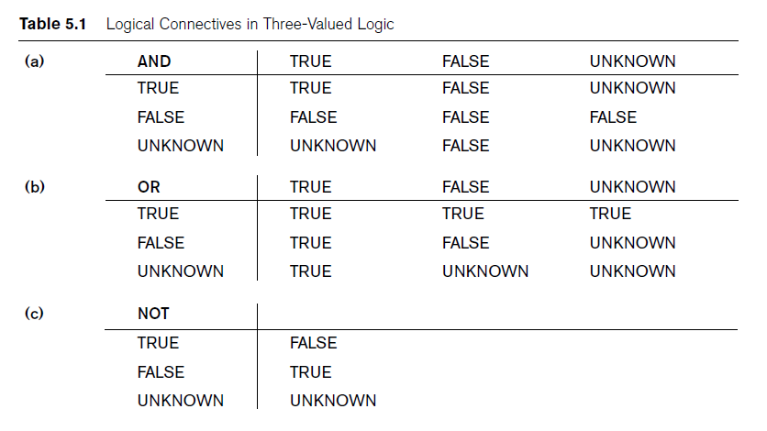
Comparisons Involving NULL and Three-Valued Logic
Slide 8- ‹#›

Slide 34
Comparisons Involving NULL and Three-Valued Logic
SQL allows queries that check whether an attribute value is NULL. Rather than using = or <> to compare an attribute value to NULL, SQL uses the comparison operators IS or IS NOT. This is because SQL considers each NULL value as being distinct from every other NULL value, so equality comparison is not appropriate
Retrieve the names of all employees who do not have supervisors.
Q18: SELECT Fname, Lname
FROM EMPLOYEE
WHERE Super_ssn IS NULL;
Slide 8- ‹#›

Slide 35
NESTING OF QUERIES
A complete SELECT query, called a nested query, can be specified within the WHERE-clause of another query, called the outer query
Many of the previous queries can be specified in an alternative form using nesting
Query 1: Retrieve the name and address of all employees who work for the 'Research' department.
Q1: SELECT FNAME, LNAME, ADDRESS FROM EMPLOYEE WHERE DNO IN (SELECT DNUMBER FROM DEPARTMENT WHERE DNAME='Research' )
Slide 8- ‹#›
Notes:
‹#›

Slide 36
NESTING OF QUERIES (contd.)
The nested query selects the number of the 'Research' department
The outer query select an EMPLOYEE tuple if its DNO value is in the result of either nested query
The comparison operator IN compares a value v with a set (or multi-set) of values V, and evaluates to TRUE if v is one of the elements in V
In general, we can have several levels of nested queries
A reference to an unqualified attribute refers to the relation declared in the innermost nested query
In this example, the nested query is not correlated with the outer query
Slide 8- ‹#›
Notes:
‹#›

Slide 37
NESTING OF QUERIES (contd.)
SQL allows the use of tuples of values in comparisons by placing them within parentheses. To illustrate this, consider the following query:
SELECT DISTINCT Essn
FROM WORKS_ON
WHERE (Pno, Hours) IN ( SELECT Pno, Hours
FROM WORKS_ON
WHERE Essn=‘123456789’ );
This query will select the Essns of all employees who work the same (project, hours) combination on some project that employee ‘John Smith’ (whose Ssn = ‘123456789’) works on. In this example, the IN operator compares the subtuple of values in parentheses (Pno, Hours) within each tuple in WORKS_ON with the set of type-compatible tuples produced by the nested query
Slide 8- ‹#›
Notes:
‹#›

Slide 38
NESTING OF QUERIES (contd.)
In addition to the IN operator, a number of other comparison operators can be used to compare a single value v (typically an attribute name) to a set or multiset v (typically a nested query).
The = ANY (or = SOME) operator returns TRUE if the value v is equal to some value in the set V and is hence equivalent to IN.
The two keywords ANY and SOME have the same effect.
Other operators that can be combined with ANY (or SOME) include >, >=, <, <=, and <>.
The keyword ALL can also be combined with each of these operators.
For example, the comparison condition (v > ALL V) returns TRUE if the value v is greater than all the values in the set (or multiset) V.
Slide 8- ‹#›
Notes:
‹#›

Slide 39
NESTING OF QUERIES (contd.)
The following query returns the names of employees whose salary is greater than the salary of all the employees in department 5:
SELECT Lname, Fname
FROM EMPLOYEE
WHERE Salary > ALL ( SELECT Salary
FROM EMPLOYEE
WHERE Dno=5 );
Retrieve the name of each employee who has a dependent with the same first name and is the same sex as the employee.
Q16: SELECT E.Fname, E.Lname
FROM EMPLOYEE AS E
WHERE E.Ssn IN ( SELECT Essn
FROM DEPENDENT AS D
WHERE E.Fname=D.Dependent_name AND E.Sex=D.Sex );
Slide 8- ‹#›
Notes:
‹#›

Slide 40
CORRELATED NESTED QUERIES
If a condition in the WHERE-clause of a nested query references an attribute of a relation declared in the outer query, the two queries are said to be correlated
The result of a correlated nested query is different for each tuple (or combination of tuples) of the relation(s) the outer query
Query 12: Retrieve the name of each employee who has a dependent with the same first name as the employee. Q12: SELECT E.FNAME, E.LNAME FROM EMPLOYEE AS E WHERE E.SSN IN (SELECT ESSN FROM DEPENDENT WHERE ESSN=E.SSN AND E.FNAME=DEPENDENT_NAME)
Slide 8- ‹#›
Notes:
‹#›

Slide 41
CORRELATED NESTED QUERIES (contd.)
In Q12, the nested query has a different result in the outer query
A query written with nested SELECT... FROM... WHERE... blocks and using the = or IN comparison operators can always be expressed as a single block query. For example, Q12 may be written as in Q12A
Q12A: SELECT E.FNAME, E.LNAME FROM EMPLOYEE E, DEPENDENT D WHERE E.SSN=D.ESSN AND E.FNAME=D.DEPENDENT_NAME
Slide 8- ‹#›
Notes:
‹#›

Slide 42
CORRELATED NESTED QUERIES (contd.)
The original SQL as specified for SYSTEM R also had a CONTAINS comparison operator, which is used in conjunction with nested correlated queries
This operator was dropped from the language, possibly because of the difficulty in implementing it efficiently
Most implementations of SQL do not have this operator
The CONTAINS operator compares two sets of values, and returns TRUE if one set contains all values in the other set
Reminiscent of the division operation of algebra
Slide 8- ‹#›
Notes:
‹#›

Slide 43
CORRELATED NESTED QUERIES (contd.)
Query 3: Retrieve the name of each employee who works on all the projects controlled by department number 5.
Q3: SELECT FNAME, LNAME FROM EMPLOYEE WHERE ( (SELECT PNO FROM WORKS_ON WHERE SSN=ESSN) CONTAINS (SELECT PNUMBER FROM PROJECT WHERE DNUM=5) )
Slide 8- ‹#›
Notes:
‹#›

Slide 44
CORRELATED NESTED QUERIES (contd.)
In Q3, the second nested query, which is not correlated with the outer query, retrieves the project numbers of all projects controlled by department 5
The first nested query, which is correlated, retrieves the project numbers on which the employee works, which is different for each employee tuple because of the correlation
Slide 8- ‹#›
Notes:
‹#›

Slide 45
THE EXISTS FUNCTION
EXISTS is used to check whether the result of a correlated nested query is empty (contains no tuples) or not
We can formulate Query 12 in an alternative form that uses EXISTS as Q12B
Slide 8- ‹#›
Notes:
‹#›

Slide 46
THE EXISTS FUNCTION (contd.)
Query 12: Retrieve the name of each employee who has a dependent with the same first name as the employee.
Q12B: SELECT FNAME, LNAME FROM EMPLOYEE WHERE EXISTS (SELECT * FROM DEPENDENT WHERE SSN=ESSN AND FNAME=DEPENDENT_NAME)
Slide 8- ‹#›
Notes:
‹#›

Slide 47
THE EXISTS FUNCTION (contd.)
Query 6: Retrieve the names of employees who have no dependents.
Q6: SELECT FNAME, LNAME FROM EMPLOYEE WHERE NOT EXISTS (SELECT * FROM DEPENDENT WHERE SSN=ESSN)
In Q6, the correlated nested query retrieves all DEPENDENT tuples related to an EMPLOYEE tuple. If none exist, the EMPLOYEE tuple is selected
EXISTS is necessary for the expressive power of SQL
Slide 8- ‹#›
Notes:
‹#›

Slide 48
EXPLICIT SETS
It is also possible to use an explicit (enumerated) set of values in the WHERE-clause rather than a nested query
Query 13: Retrieve the social security numbers of all employees who work on project number 1, 2, or 3.
Q13: SELECT DISTINCT ESSN FROM WORKS_ON WHERE PNO IN (1, 2, 3)
Slide 8- ‹#›
Notes:
‹#›

Slide 49
NULLS IN SQL QUERIES
SQL allows queries that check if a value is NULL (missing or undefined or not applicable)
SQL uses IS or IS NOT to compare NULLs because it considers each NULL value distinct from other NULL values, so equality comparison is not appropriate.
Query 14: Retrieve the names of all employees who do not have supervisors.
Q14: SELECT FNAME, LNAME FROM EMPLOYEE WHERE SUPERSSN IS NULL
Note: If a join condition is specified, tuples with NULL values for the join attributes are not included in the result
Slide 8- ‹#›
Notes:
‹#›

Slide 50
Joined Relations Feature in SQL2
Can specify a "joined relation" in the FROM-clause
Looks like any other relation but is the result of a join
Allows the user to specify different types of joins (regular "theta" JOIN, NATURAL JOIN, LEFT OUTER JOIN, RIGHT OUTER JOIN, CROSS JOIN, etc)
Slide 8- ‹#›
Notes:
‹#›

Slide 51
Joined Relations Feature in SQL2 (contd.)
Examples:
Q8: SELECT E.FNAME, E.LNAME, S.FNAME, S.LNAME FROM EMPLOYEE E S WHERE E.SUPERSSN=S.SSN
can be written as:
Q8: SELECT E.FNAME, E.LNAME, S.FNAME, S.LNAME FROM (EMPLOYEE E LEFT OUTER JOIN EMPLOYEES ON E.SUPERSSN=S.SSN)
Slide 8- ‹#›
Notes:
‹#›

Slide 52
Joined Relations Feature in SQL2 (contd.)
Examples:
Q1: SELECT FNAME, LNAME, ADDRESS FROM EMPLOYEE, DEPARTMENT WHERE DNAME='Research' AND DNUMBER=DNO
could be written as:
Q1: SELECT FNAME, LNAME, ADDRESS FROM (EMPLOYEE JOIN DEPARTMENT ON DNUMBER=DNO) WHERE DNAME='Research’
or as:
Q1: SELECT FNAME, LNAME, ADDRESS FROM (EMPLOYEE NATURAL JOIN DEPARTMENT AS DEPT(DNAME, DNO, MSSN, MSDATE) WHERE DNAME='Research’
Slide 8- ‹#›
Notes:
‹#›

Slide 53
Joined Relations Feature in SQL2 (contd.)
Another Example: Q2 could be written as follows; this illustrates multiple joins in the joined tables
Q2: SELECT PNUMBER, DNUM, LNAME, BDATE, ADDRESS FROM (PROJECT JOIN DEPARTMENT ON DNUM=DNUMBER) JOIN EMPLOYEE ON MGRSSN=SSN) ) WHERE PLOCATION='Stafford’
Slide 8- ‹#›
Notes:
‹#›

Slide 54
AGGREGATE FUNCTIONS
Include COUNT, SUM, MAX, MIN, and AVG
Query 15: Find the maximum salary, the minimum salary, and the average salary among all employees.
Q15: SELECT MAX(SALARY), MIN(SALARY), AVG(SALARY) FROM EMPLOYEE
Some SQL implementations may not allow more than one function in the SELECT-clause
Slide 8- ‹#›
Notes:
‹#›

Slide 55
AGGREGATE FUNCTIONS (contd.)
Query 16: Find the maximum salary, the minimum salary, and the average salary among employees who work for the 'Research' department.
Q16: SELECT MAX(SALARY), MIN(SALARY), AVG(SALARY) FROM EMPLOYEE, DEPARTMENT WHERE DNO=DNUMBER AND DNAME='Research'
Slide 8- ‹#›
Notes:
‹#›

Slide 56
AGGREGATE FUNCTIONS (contd.)
Queries 17 and 18: Retrieve the total number of employees in the company (Q17), and the number of employees in the 'Research' department (Q18).
Q17: SELECT COUNT (*) FROM EMPLOYEE
Q18: SELECT COUNT (*) FROM EMPLOYEE, DEPARTMENT WHERE DNO=DNUMBER AND DNAME='Research’
Slide 8- ‹#›
Notes:
‹#›

Slide 57
GROUPING
In many cases, we want to apply the aggregate functions to subgroups of tuples in a relation
Each subgroup of tuples consists of the set of tuples that have the same value for the grouping attribute(s)
The function is applied to each subgroup independently
SQL has a GROUP BY-clause for specifying the grouping attributes, which must also appear in the SELECT-clause
Slide 8- ‹#›
Notes:
‹#›

Slide 58
GROUPING (contd.)
Query 20: For each department, retrieve the department number, the number of employees in the department, and their average salary.
Q20: SELECT DNO, COUNT (*), AVG (SALARY) FROM EMPLOYEE GROUP BY DNO
In Q20, the EMPLOYEE tuples are divided into groups-
Each group having the same value for the grouping attribute DNO
The COUNT and AVG functions are applied to each such group of tuples separately
The SELECT-clause includes only the grouping attribute and the functions to be applied on each group of tuples
A join condition can be used in conjunction with grouping
Slide 8- ‹#›
Notes:
‹#›

Slide 59
GROUPING (contd.)
Query 21: For each project, retrieve the project number, project name, and the number of employees who work on that project.
Q21: SELECT PNUMBER, PNAME, COUNT (*) FROM PROJECT, WORKS_ON WHERE PNUMBER=PNO GROUP BY PNUMBER, PNAME
In this case, the grouping and functions are applied after the joining of the two relations
Slide 8- ‹#›
Notes:
‹#›

Slide 60
THE HAVING-CLAUSE
Sometimes we want to retrieve the values of these functions for only those groups that satisfy certain conditions
The HAVING-clause is used for specifying a selection condition on groups (rather than on individual tuples)
Slide 8- ‹#›
Notes:
‹#›

Slide 61
THE HAVING-CLAUSE (contd.)
Query 22: For each project on which more than two employees work, retrieve the project number, project name, and the number of employees who work on that project.
Q22: SELECT PNUMBER, PNAME, COUNT(*) FROM PROJECT, WORKS_ON WHERE PNUMBER=PNO GROUP BY PNUMBER, PNAME HAVING COUNT (*) > 2
Slide 8- ‹#›
Notes:
‹#›

Slide 62
SUBSTRING COMPARISON
The LIKE comparison operator is used to compare partial strings
Two reserved characters are used: '%' (or '*' in some implementations) replaces an arbitrary number of characters, and '_' replaces a single arbitrary character
Slide 8- ‹#›
Notes:
‹#›

Slide 63
SUBSTRING COMPARISON (contd.)
Query 25: Retrieve all employees whose address is in Houston, Texas. Here, the value of the ADDRESS attribute must contain the substring 'Houston,TX‘ in it.
Q25: SELECT FNAME, LNAME FROM EMPLOYEE WHERE ADDRESS LIKE '%Houston,TX%'
Slide 8- ‹#›
Notes:
‹#›

Slide 64
SUBSTRING COMPARISON (contd.)
Query 26: Retrieve all employees who were born during the 1950s.
Here, '5' must be the 8th character of the string (according to our format for date), so the BDATE value is '_______5_', with each underscore as a place holder for a single arbitrary character.
Q26: SELECT FNAME, LNAME FROM EMPLOYEE WHERE BDATE LIKE '_______5_’
The LIKE operator allows us to get around the fact that each value is considered atomic and indivisible
Hence, in SQL, character string attribute values are not atomic
Slide 8- ‹#›
Notes:
‹#›

Slide 65
ARITHMETIC OPERATIONS
The standard arithmetic operators '+', '-'. '*', and '/' (for addition, subtraction, multiplication, and division, respectively) can be applied to numeric values in an SQL query result
Query 27: Show the effect of giving all employees who work on the 'ProductX' project a 10% raise.
Q27: SELECT FNAME, LNAME, 1.1*SALARY FROM EMPLOYEE, WORKS_ON, PROJECT WHERE SSN=ESSN AND PNO=PNUMBER AND PNAME='ProductX’
Slide 8- ‹#›
Notes:
‹#›

Slide 66
ORDER BY
The ORDER BY clause is used to sort the tuples in a query result based on the values of some attribute(s)
Query 28: Retrieve a list of employees and the projects each works in, ordered by the employee's department, and within each department ordered alphabetically by employee last name.
Q28: SELECT DNAME, LNAME, FNAME, PNAME FROM DEPARTMENT, EMPLOYEE, WORKS_ON, PROJECT WHERE DNUMBER=DNO AND SSN=ESSN AND PNO=PNUMBER ORDER BY DNAME, LNAME
Slide 8- ‹#›
Notes:
‹#›

Slide 67
ORDER BY (contd.)
The default order is in ascending order of values
We can specify the keyword DESC if we want a descending order; the keyword ASC can be used to explicitly specify ascending order, even though it is the default
Slide 8- ‹#›
Notes:
‹#›

Slide 68
Summary of SQL Queries
A query in SQL can consist of up to six clauses, but only the first two, SELECT and FROM, are mandatory. The clauses are specified in the following order: SELECT <attribute list> FROM <table list> [WHERE <condition>] [GROUP BY <grouping attribute(s)>] [HAVING <group condition>] [ORDER BY <attribute list>]
Slide 8- ‹#›
Notes:
‹#›

Slide 69
Summary of SQL Queries (contd.)
The SELECT-clause lists the attributes or functions to be retrieved
The FROM-clause specifies all relations (or aliases) needed in the query but not those needed in nested queries
The WHERE-clause specifies the conditions for selection and join of tuples from the relations specified in the FROM-clause
GROUP BY specifies grouping attributes
HAVING specifies a condition for selection of groups
ORDER BY specifies an order for displaying the result of a query
A query is evaluated by first applying the WHERE-clause, then GROUP BY and HAVING, and finally the SELECT-clause
Slide 8- ‹#›
Notes:
‹#›

Slide 70
Specifying Updates in SQL
There are three SQL commands to modify the database: INSERT, DELETE, and UPDATE
Slide 8- ‹#›
Notes:
‹#›

Slide 71
INSERT
In its simplest form, it is used to add one or more tuples to a relation
Attribute values should be listed in the same order as the attributes were specified in the CREATE TABLE command
Slide 8- ‹#›
Notes:
‹#›

Slide 72
INSERT (contd.)
Example:
U1: INSERT INTO EMPLOYEE VALUES ('Richard','K','Marini', '653298653', '30-DEC-52', '98 Oak Forest,Katy,TX', 'M', 37000,'987654321', 4 )
An alternate form of INSERT specifies explicitly the attribute names that correspond to the values in the new tuple
Attributes with NULL values can be left out
Example: Insert a tuple for a new EMPLOYEE for whom we only know the FNAME, LNAME, and SSN attributes.
U1A: INSERT INTO EMPLOYEE (FNAME, LNAME, SSN) VALUES ('Richard', 'Marini', '653298653')
Slide 8- ‹#›
Notes:
‹#›

Slide 73
INSERT (contd.)
Important Note: Only the constraints specified in the DDL commands are automatically enforced by the DBMS when updates are applied to the database
Another variation of INSERT allows insertion of multiple tuples resulting from a query into a relation
Slide 8- ‹#›
Notes:
‹#›

Slide 74
INSERT (contd.)
Example: Suppose we want to create a temporary table that has the name, number of employees, and total salaries for each department.
A table DEPTS_INFO is created by U3A, and is loaded with the summary information retrieved from the database by the query in U3B.
U3A: CREATE TABLE DEPTS_INFO (DEPT_NAME VARCHAR(10), NO_OF_EMPS INTEGER, TOTAL_SAL INTEGER);
U3B: INSERT INTO DEPTS_INFO (DEPT_NAME, NO_OF_EMPS, TOTAL_SAL) SELECT DNAME, COUNT (*), SUM (SALARY) FROM DEPARTMENT, EMPLOYEE WHERE DNUMBER=DNO GROUP BY DNAME ;
Slide 8- ‹#›
Notes:
‹#›

Slide 75
INSERT (contd.)
Note: The DEPTS_INFO table may not be up-to-date if we change the tuples in either the DEPARTMENT or the EMPLOYEE relations after issuing U3B. We have to create a view (see later) to keep such a table up to date.
Slide 8- ‹#›
Notes:
‹#›

Slide 76
DELETE
Removes tuples from a relation
Includes a WHERE-clause to select the tuples to be deleted
Referential integrity should be enforced
Tuples are deleted from only one table at a time (unless CASCADE is specified on a referential integrity constraint)
A missing WHERE-clause specifies that all tuples in the relation are to be deleted; the table then becomes an empty table
The number of tuples deleted depends on the number of tuples in the relation that satisfy the WHERE-clause
Slide 8- ‹#›
Notes:
‹#›

Slide 77
DELETE (contd.)
Examples:
U4A: DELETE FROM EMPLOYEE WHERE LNAME='Brown’
U4B: DELETE FROM EMPLOYEE WHERE SSN='123456789’
U4C: DELETE FROM EMPLOYEE WHERE DNO IN (SELECT DNUMBER FROM DEPARTMENT WHERE DNAME='Research')
U4D: DELETE FROM EMPLOYEE
Slide 8- ‹#›
Notes:
‹#›

Slide 78
UPDATE
Used to modify attribute values of one or more selected tuples
A WHERE-clause selects the tuples to be modified
An additional SET-clause specifies the attributes to be modified and their new values
Each command modifies tuples in the same relation
Referential integrity should be enforced
Slide 8- ‹#›
Notes:
‹#›

Slide 79
UPDATE (contd.)
Example: Change the location and controlling department number of project number 10 to 'Bellaire' and 5, respectively.
U5: UPDATE PROJECT SET PLOCATION = 'Bellaire', DNUM = 5 WHERE PNUMBER=10
Slide 8- ‹#›
Notes:
‹#›

Slide 80
UPDATE (contd.)
Example: Give all employees in the 'Research' department a 10% raise in salary.
U6: UPDATE EMPLOYEE SET SALARY = SALARY *1.1 WHERE DNO IN (SELECT DNUMBER FROM DEPARTMENT WHERE DNAME='Research')
In this request, the modified SALARY value depends on the original SALARY value in each tuple
The reference to the SALARY attribute on the right of = refers to the old SALARY value before modification
The reference to the SALARY attribute on the left of = refers to the new SALARY value after modification
Slide 8- ‹#›
Notes:
‹#›

Slide 81
Recap of SQL Queries
A query in SQL can consist of up to six clauses, but only the first two, SELECT and FROM, are mandatory. The clauses are specified in the following order: SELECT <attribute list> FROM <table list> [WHERE <condition>] [GROUP BY <grouping attribute(s)>] [HAVING <group condition>] [ORDER BY <attribute list>]
There are three SQL commands to modify the database: INSERT, DELETE, and UPDATE
Slide 8- ‹#›
Notes:
‹#›

